Slide 1

SQL Commands

Slide 2
SQL Commands can be majorly classified in five categories.
1. DDL (Data Definition Language)
2. DML (Data Manipulation Language)
3. TCL (Transaction Control Language)
4. DCL (Data Control Language)
5. DQL (Data Query Language)

Slide 3
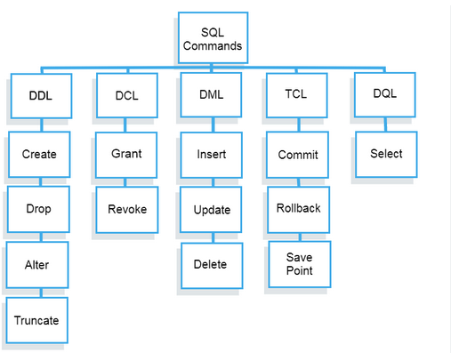

Slide 4



DDL – Data Definition Language
Data Definition Language actually consists of the SQL commands that can be used to define the database schema.
It simply deals with descriptions of the database schema and is used to create and modify the structure of database objects in the database.
Let’s understand all the keywords in DDL.

Slide 5
CREATE
Create keyword can be used to create different database objects like tables, indexes, views etc.
A table in databases is used to store data in a tabular format i.e. in form of rows and columns. It is similar like spreadsheet.
A table creation command requires three things i.e. Name of Table, Name of fields (columns) in table, Data Type for each column.
Syntax:
CREATE TABLE TABLE_NAME (
COLUMN1 DATATYPE,
COLUMN2 DATATYPE);

Slide 6
ALTER(Adding column to a table)
Alter command goes in combination with add, rename, modify and drop. We will look at the add scenarios first.
2. Suppose, you want to add a column or multiple columns to an existing table, delete a column or multiple columns in a existing table, rename a column or multiple columns in an existing table.
e.g. Let’s suppose you have students table and you want to add a column age in that table so you can use the below syntax
Alter table table_name add column column_name datatype;
Alter table students add column age int unsigned;
Now, let’s suppose you want to add height, weight and scores in the same table so you can use the below syntax.
Alter table table_name add column column_name datatype, add column column_name datatype..
Alter table students add column height decimal (5,1), add column weight decimal (5,2), add column score int unsigned;
DO NOT WORRY WE WILL BE DISCUSSING DATATYPES IN THE FURTHER SESSIONS.

Slide 7
3. Adding columns in the above manner will add the column at the end of the table.
4. If in case you want to add the column at a specific position you can use the below syntax:
Alter table table_name add column column_name data type after column_name;
e.g. You want to add a column as Date of Birth next to the age column in the students table so the syntax will be
Alter table students add column date_of_birth date after age;
NOTE: There is nothing called as before however, if you would like to add a column at the beginning it means that it should be the first column in your table you can use the below syntax:
Alter table table_name add column column_name datatype first;
e.g. Let’s supposed you want to add a new column student_id and that should be the first column in your table you can use the below syntax:
Alter table students add column student_id int unsigned first;

Slide 8
ALTER(Renaming a column in a table)
You can use the rename along with the ALTER keyword whenever you would like to rename a column
In the last slide you added a column named as student_id at the first position in the table. Let’s suppose you want to rename this column just to ID, so you can use the below syntax:
Alter table table_name rename column old_ column_name to new_column_name;
Alter table students rename column student_id to id;
3. If in case you want to rename multiple columns in one single query. Suppose you want to change the height, weight and score column names to something the columns that we added in the last slide.
Alter table table_name rename old_column_name to new_column_name, rename old_column_name to new_ column_name;
Alter table students rename column height to Tall, rename column weight to heavy, rename column score to
points.

Slide 9
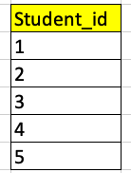
ALTER(Modifying column properties)
Modify keyword is also used along with the ALTER statement and it is useful for changing the data type of the column (logically if it is possible) or increasing the space or size of a column.
Consider the below example there is a column named a student_id and it was stored in text in the students table and now we want to convert the same in the integer format.
You, can use the below syntax for the same.
Alter table table_name modify column column_name datatype;
Alter table students modify column student_id int unsigned;
Alter table table_name modify column column_name varchar(30)
The size of the column was Varchar(20). Using this query I changed the size of the column to Varchar(30).

Slide 10
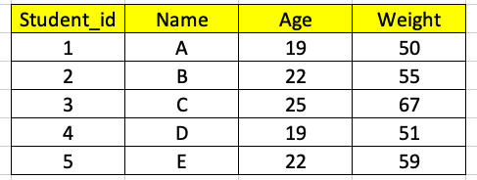
ALTER(Dropping Column from a table)
Consider the below students table.
Let’s suppose in this table you don’t want the weight column in your table i.e. you want to delete this column. So, you can use the DROP keyword in the ALTER statement in the below manner .
Alter table table_name drop column column_name;
Alter table students drop column weight;
If, you want to drop two or three columns together in one statement you can use the below syntax.
Alter table table_name drop column column_name, drop column_column_name;
Alter table students drop column Name, drop column age;

Slide 11
DROP TABLE OR DATABASE
Consider the below students table.
Let’s suppose the above table students is of no use now as it contains only redundant data and you would like to delete this table from the database you can write the below query.
DROP TABLE TABLE_NAME
DROP Table Students;
If in case at any point of time you would like to get rid of the complete database you will write the below query.
DROP Database Database_Name;
Remember, DROP is a DDL statement which is on auto save it means if you drop the table or database like this it is permanently gone.

Slide 12
TRUNCATE
Truncate statement empties the entire table.
Let’s suppose you have students table which has 10,000 rows of data in it. If you write a TRUNCATE statement on the table all the rows (10,000) will be deleted in one go.
Consider the below table i.e. students
As you can see in the above table there are five rows if I write the below query all the five rows will be deleted in one go.
Truncate table table_name;
Truncate Table students;

Slide 13
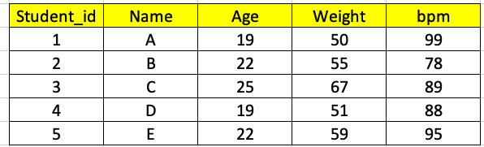
COMMENT
Sometimes in tables we have some columns which are not easy to understand so we can leave a comment on the column so that it is easy for the end user to understand the real meaning of such columns.
Consider the below table students. We can understand all the columns but we are not sure what this bpm column means. So, what we can do is we can leave a comment on the column.
We can use the below syntax to put a comment on the column.
Alter table table_name modify column column name datatype comment “ Your comments”
Alter table students modify column bpm int unsigned comment “ Heart Beat for the student”.
In order to check the comments on a column we can write the below query:
Show full columns from table_name;
Show full columns from students;

Slide 14

DML & TCL
Data Manipulation Language helps us to work on the exact data points i.e. it helps us to work with the rows in a table as rows in a table consist of a exact data points.
Whenever, you make changes to the data in the table you need to confirm that whether you would like to save the changes that you have made or you would like to undo those changes.
For this reason Data Manipulation Language and Transaction Control Language goes hand in hand as DML will help you to make changes to the data values and TCL will help you to save or undo the changes that you have made.
Every time you write a DML statement a transaction gets initiated in the background and you need to write TCL statements to close that transaction.

Slide 15
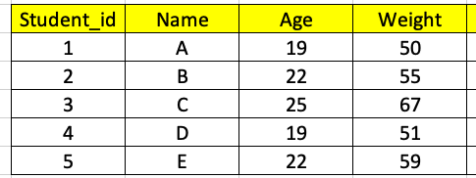
DML Keywords – (INSERT, UPDATE, DELETE)
INSERT
Insert keyword or statement is used whenever we want to insert values in a table.
Consider this example. I have a table named students as shown in the screenshot below.
I want to add a new row for the student named F so I will use the below syntax.
Insert into table_name values (col1value,col2value,col3value,col4value)
Insert into students values (6,’F’,22,79);
Note: Make sure the values you are mentioning it should be in the same sequence as per the column name as the first value will go to column1, second value will go to column2 and so on.
4. If in case you know the values only for let’s say student_id and Weight and you want to insert values only in these two columns ( condition that there is no not null constraint on any column) you can use the below query
Insert into students (student_id,weight) values (6,70);

Slide 16

Once you have inserted the data, only you and only you can see the data in the table. If there are other people who have access to the same table and they try to see the data that you have inserted they will not be able to see anything as INSERT is a DML statement and every DML statement needs to be saved in order to make the changes permanent in the table.
🡪 In order to save the DML statement like in this scenario the INSERT statement you will write the below TCL command and execute it which acts like CTRL+S of Excel.
COMMIT;
🡪 Let’s suppose you have inserted some rows into a table and later you realized that you would not like to go ahead in saving those records so you can write the below statements which acts like CTRL+Z of Excel.
ROLLBACK;

Slide 17
DML Keywords – (INSERT, UPDATE, DELETE)
DELETE
Delete keyword or statement is used to delete the values in a table.
Consider this example. I have a table named students as shown in the screenshot below.
I want to delete the student whose name is A
Delete from table_name where condition
Delete from Students where student_id = 1;
Note: Make sure you are giving some unique identifier in the where clause for system to understand which row to delete otherwise system will delete all the rows i.e. the entire table will go empty all the rows will be deleted.

Slide 18
Once you have deleted the data, only you and only you can see the deleted data in the table. If there are other people who have access to the same table and they try to see the data they will still see the data as DELETE is a DML statement and every DML statement needs to be saved in order to make the changes permanent in the table.
🡪 In order to save the DML statement like in this scenario the Delete statement you will write the below TCL command and execute it which acts like CTRL+S of Excel.
COMMIT;
🡪 Let’s suppose you have deleted some rows into a table and later you realized that you would not like to go ahead in saving those records so you can write the below statements which acts like CTRL+Z of Excel.
ROLLBACK;

Slide 19
DML Keywords – (INSERT, UPDATE, DELETE)
UPDATE
Update keyword or statement is used update the values in a table.
Consider this example. I have a table named students as shown in the screenshot below.
I want to change the weight of the student whose name is A from 50 to 70
Update table_name set column_name = newvalue where condition;
Update students set weight = 70 where student_id = 1;
Note: Make sure you are giving some unique identifier in the where clause for system to understand which row to update otherwise system will update all the rows for that column.

Slide 20
Once you have updated the data, only you and only you can see the updated data in the table. If there are other people who have access to the same table and they try to see the data they will still see the old data as UPDATE is a DML statement and every DML statement needs to be saved in order to make the changes permanent in the table.
🡪 In order to save the DML statement like in this scenario the Update statement you will write the below TCL command and execute it which acts like CTRL+S of Excel.
COMMIT;
🡪 Let’s suppose you have updated some rows into a table and later you realized that you would not like to go ahead in saving those records so you can write the below statements which acts like CTRL+Z of Excel.
ROLLBACK;

Slide 21
DQL (Data Query Language)
DQL consist of one keyword called as SELECT.
Whenever we want to query the data from the table in a database we will make use of the SELECT statement.
If you would like to see all the data in a table in a database you can write the below query (* represents all) which means you will be able to see all the rows and columns in your data.
If you want to see only limited columns you need to write all the column names separated by comma in front of select statement.
Synatx :
Select * from table_name;
Select col1, col2,col3 from table_name;

Slide 22
DCL (Data Control Language)
DCL languages are used to control the user access to database, tables and other objects in the databases.
DCL consist of two keywords
GRANT – Whenever, we need to provide access to the user for database or its objects we make use of GRANT statement.
REVOKE – Whenever, we need to withdraw the access of a user from the database or its objects we make use of REVOKE statement.

Slide 23
MySQL Data Types
MySQL supports a wide variety of data types. Some of the most commonly used data types are listed below.
NUMERIC
DATE
DATETIME
TIMESTAMP
STRING

Slide 24
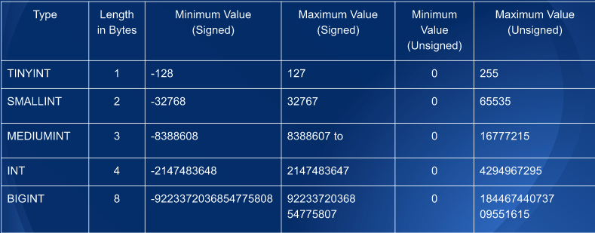
INTEGER TYPES

Slide 25
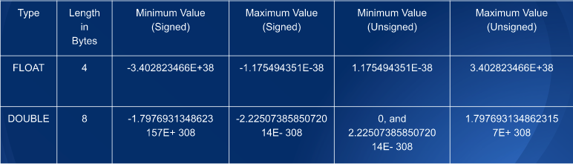
FLOATING-POINT TYPES

Slide 26
Fixed – Point Types
There is another data type as DECIMAL which is written as DECIMAL (10,3) where 10 is called as the precision and 3 is the scale. It means we will be able to store any value with 10 digits and 3 decimals.
The maximum number of digits for DECIMAL is 65, but the actual range for a given DECIMAL column can be constrained by the precision or scale of a given column.

Slide 27
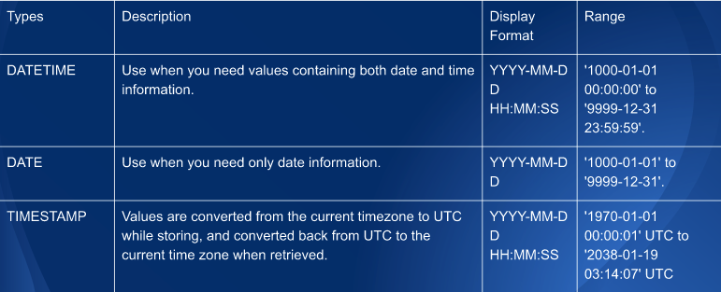
DATETIME, DATE and TIMESTAMP

Slide 28
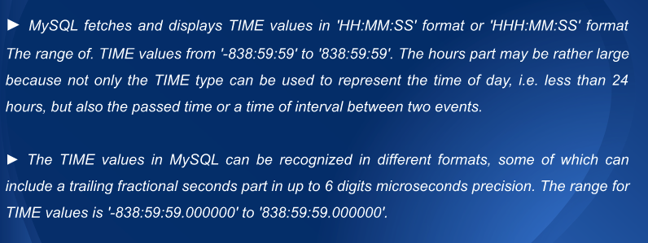
TIME TYPE

Slide 29
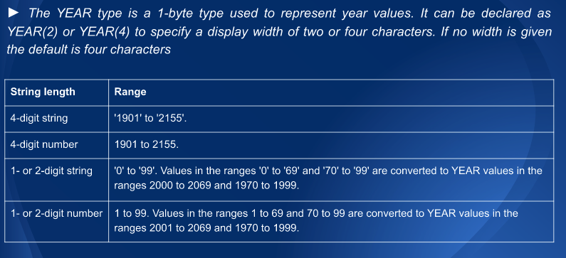
YEAR TYPE

Slide 30

STRING TYPES

Slide 31
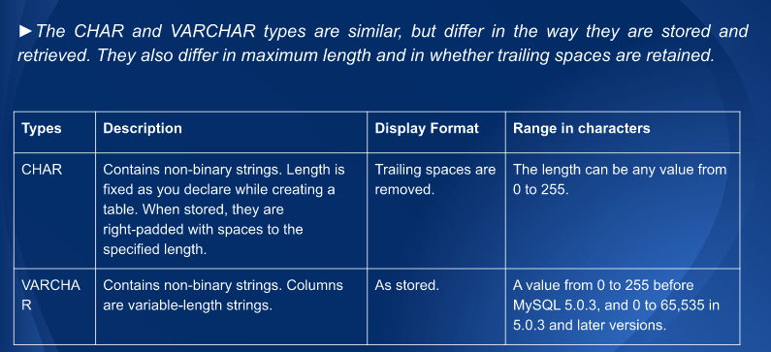
CHAR and VARCHAR Types

